Slide 1
Ruby- Web Development Project
“MAP MY LIFE”
Hannah

Slide 2
Brief
Travel Bucket List
Build an app to track someone's travel adventures.
MVP:
The app should allow the user to track countries and cities they want to visit and those they have visited.
The user should be able to create, edit and delete countries
Each country should have one or more cities to visit
The user should be able to create, edit and delete cities
The app should allow the user to mark destinations as visited or still to see
Possible Extensions:
Have separate pages for destinations visited and those still to visit
Add sights to the destination cities
Search for destination by continent, city or country
Any other ideas you might come up with

Slide 3
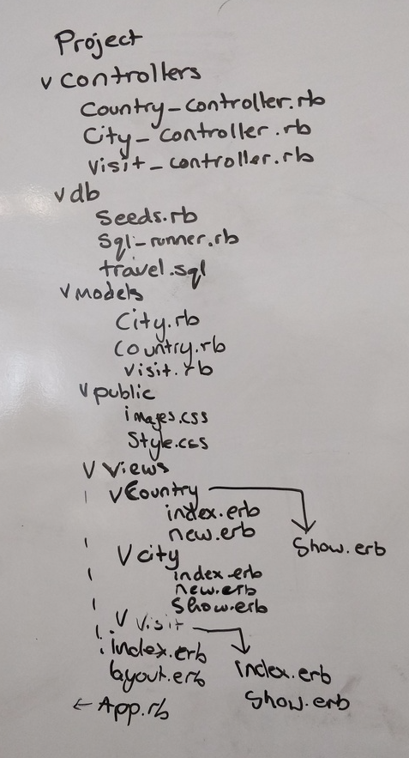
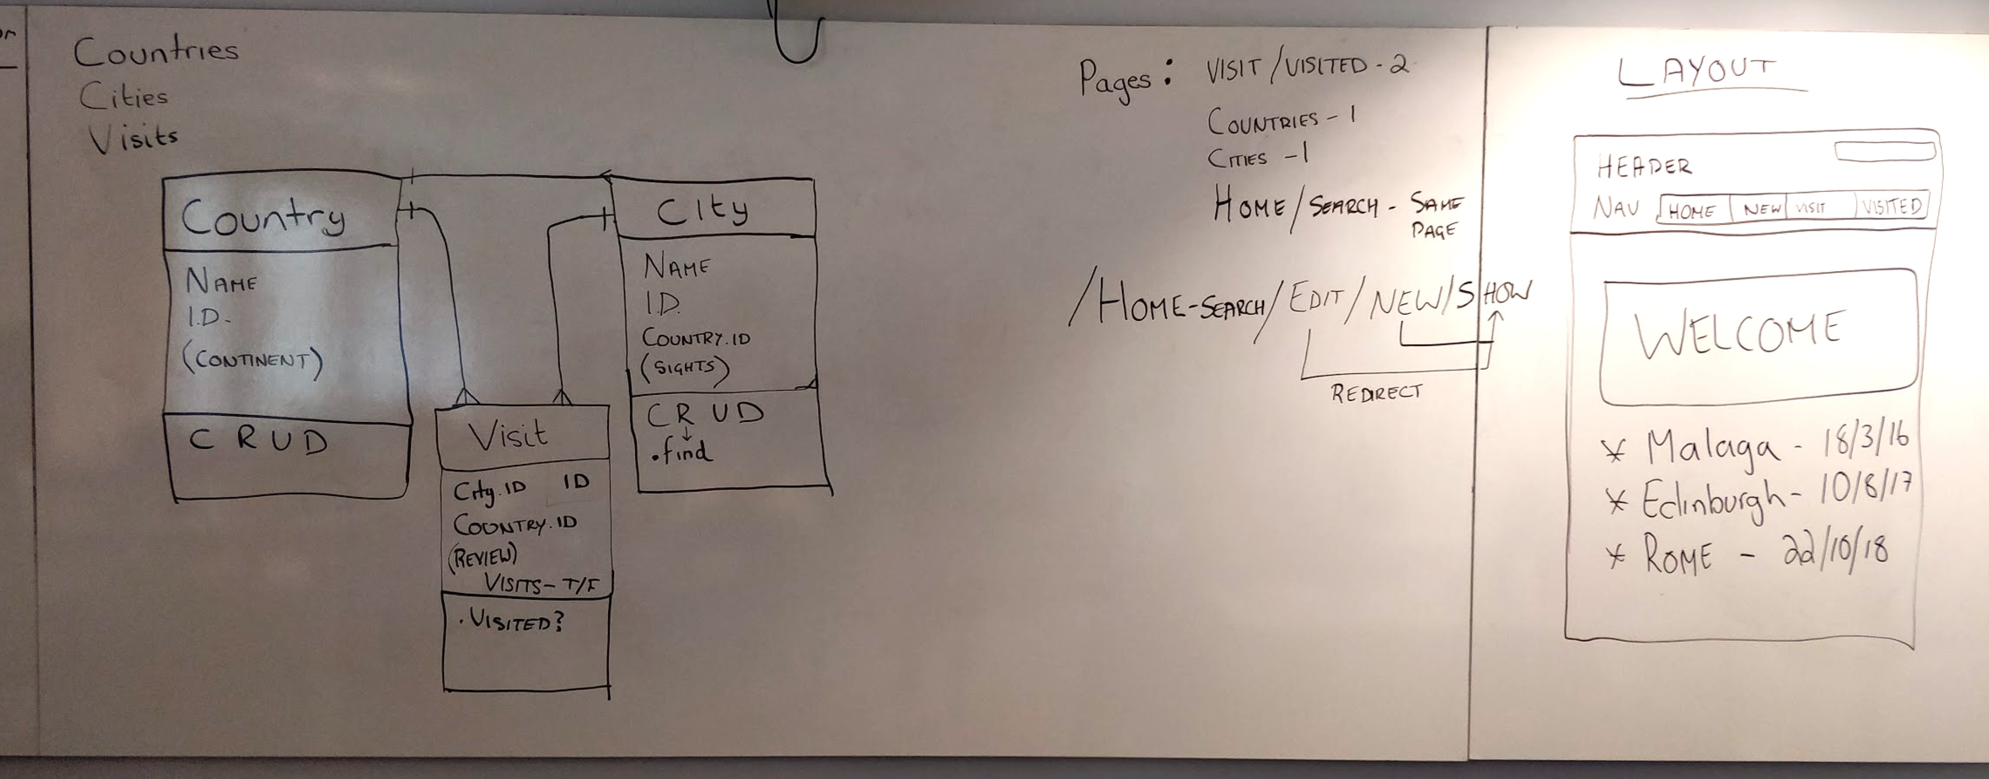
Group Planning

Slide 4
Possible project filenames:

Slide 5
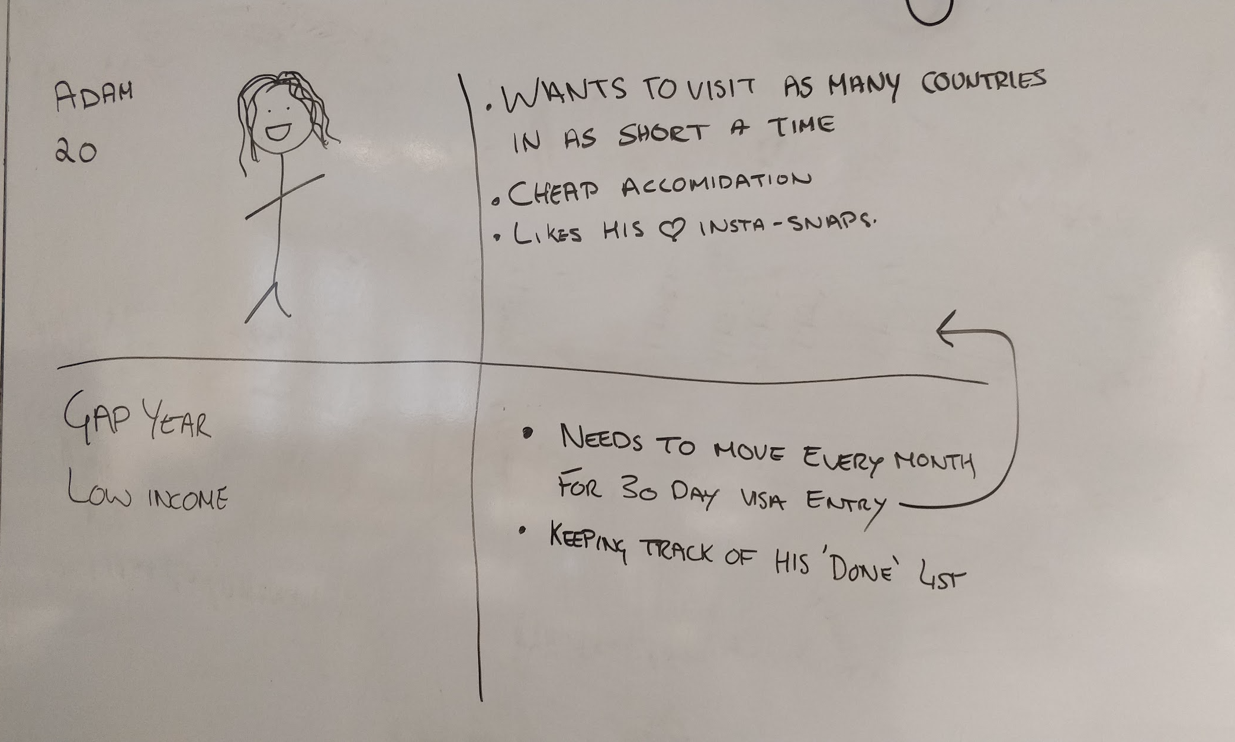
Group UX

Slide 6
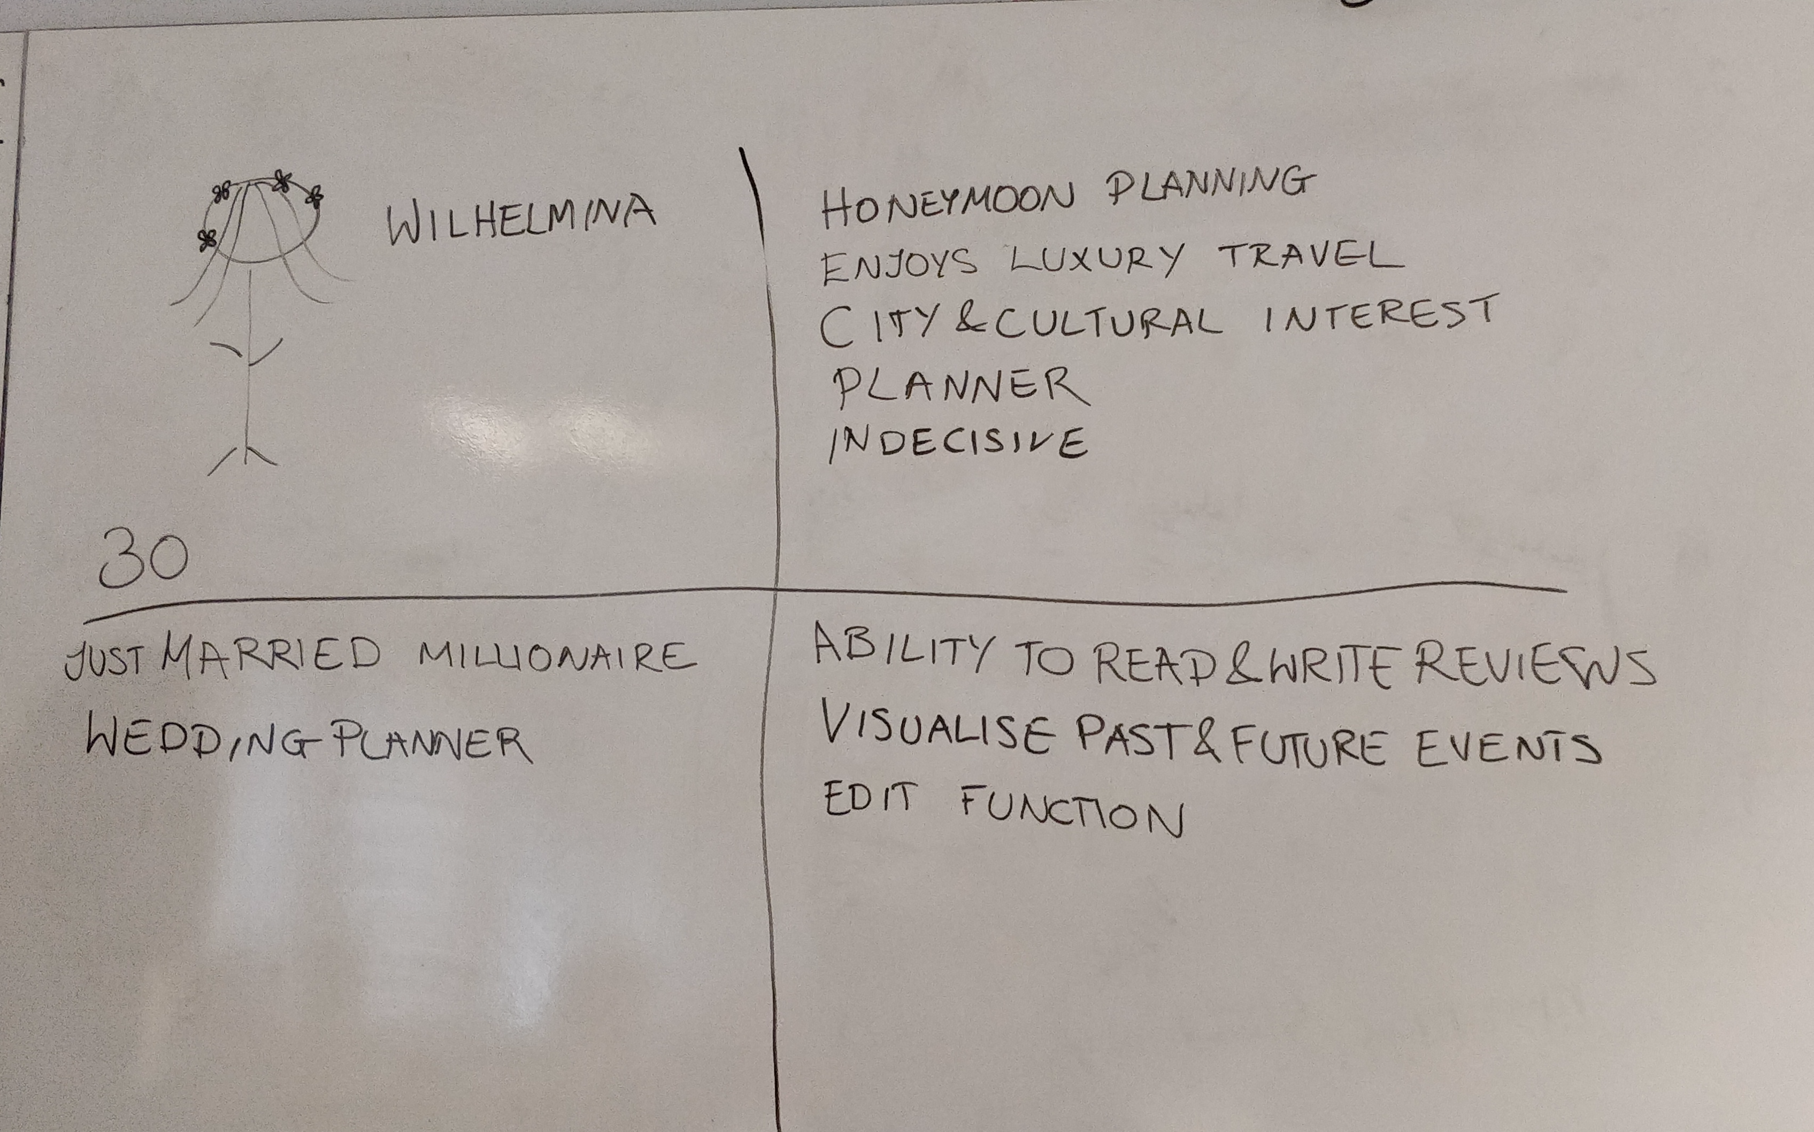
Group UX

Slide 7
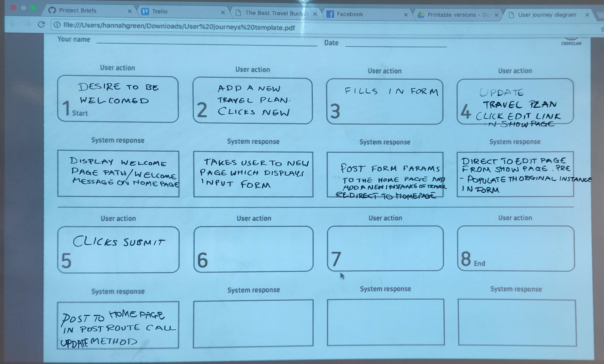
Group UX

Slide 8
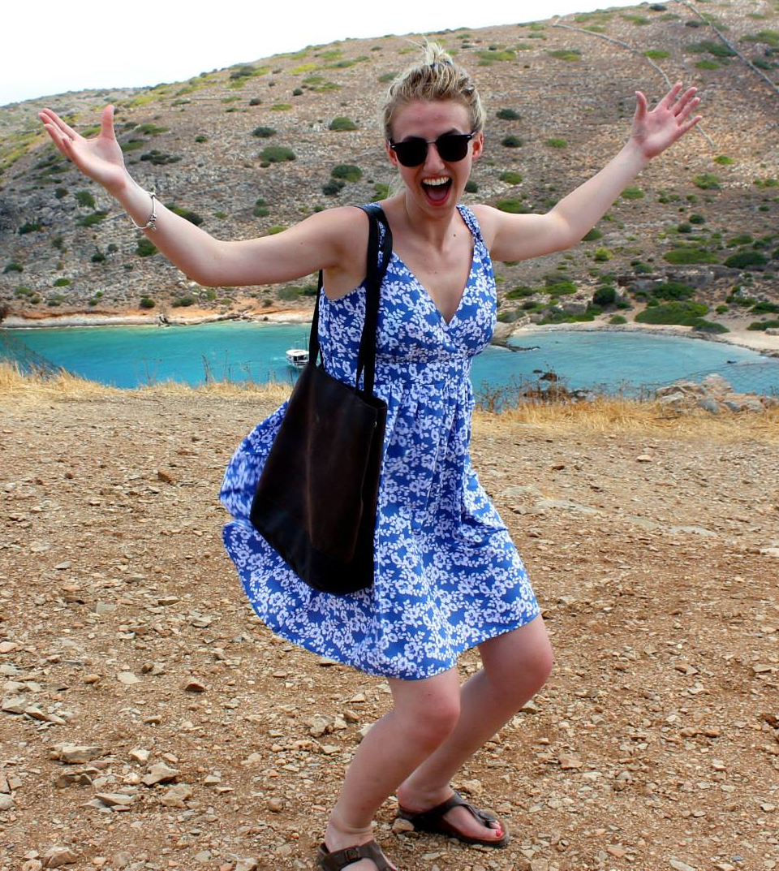
UX- Proto Personas
Emma
25
Lives in London
Married
Loves to travel to new places
Needs to be organised and have an itinerary
Sometimes organises for larger groups
She is originally from South Africa and would like to go back soon.
Has a good income to afford a couple holidays a year.
Just married and would like to organise a holiday for her husband and sister in law.
Would like to add things to see when planning her trips
Would like to tick things off when she has been there.
Her goal is to travel and see the world.

Slide 9
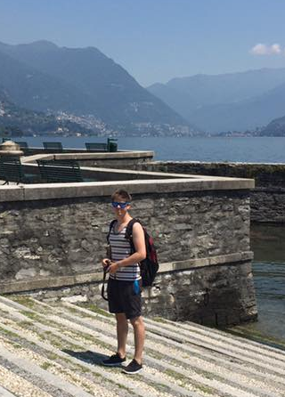
UX- Proto Personas
Jamie
23
Lives in Edinburgh
Single
Loves to travel to new places
Is usually unorganised and changes his mind a lot
Is not to comfortable with different apps so needs something that is easy to use, with a simple design
Has a lot of money to spend on holidays
Usually holidays with friends and family
Simple app with easy to use features
Be able to change and delete journeys.

Slide 10
UX

Slide 11
UX

Slide 12
Wire frames

Slide 14
Thoughts

Slide 15
Problems I had:

Slide 16
Questions

